Slide 1
ABAP Part II
Lesson 02: ABAP List Viewer

Slide 2
Lesson Objectives
After completing this lesson, participants will be able to understand the following -
Control Framework
ALV Grid
Non Event Based Functionality
Event Based Functionality

Slide 3
Introduction
The common features of report are column alignment, sorting, filtering, subtotals, totals etc.
To implement these, a lot of coding and logic is to be put.
To avoid that we can use a concept called ABAP List Viewer (ALV).
ALV (ABAP List Viewer) is a grid control, used for displaying lists.
The tool provides common list operations as generic functions and enhanced by user-defined options.
The grid control itself consists of a toolbar, a title and the output table displayed in a grid control. The user has control over the look of the grid (to certain degree) by the use of layout variants

Slide 4
Functions Provided by ALV Grid Control
Display non-hierarchical lists consistently with a modern design
Use typical list functions -such as sorting and filtering without extra programming effort
Adapt predefined list functions and their enhancements
Program responses to user actions (such as double-clicking a line) individually

Slide 5
Features
Navigating Within the List
Sorting in Ascending/Descending Order
Selecting and Deselecting Rows
Defining Exceptions
Setting and Deleting Filters
Displaying and Deleting Sums
Creating Subtotals
Optimizing the Column Width

Slide 6
Types of ALV Reports
Using ALV, we can have three types of reports:
Simple Report
Block Report
Hierarchical Sequential Report

Slide 7
Simple Report
There are some function modules which will enable to produce the above reports without much effort.
All the definitions of internal tables, structures and constants are declared in a type-pool called SLIS.
The important function modules are:
Reuse_alv_fieldcatalog_merge
Reuse_alv_list_display
Reuse_alv_grid_display

Slide 8
Simple Report
Reuse_ALV_fieldcatalog_merge:
This function module is used to populate a fieldcatalog which is essential to display the data in ALV.
If the output data is from a single dictionary table and all the columns are selected, then we need not exclusively create the field catalog.
Its enough to mention the table name as a parameter(I_structure_name) in the REUSE_ALV_LIST_DISPLAY.
In other cases, it has to be created.
Notes:
1. Export:
a. I_program_name : report id
b. I_internal_tabname : the internal output table
c. I_inclname : include or the report name where all the dynamic forms are handled.
2. Changing:
ct_fieldcat : an internal table with the type SLIS_T_FIELDCAT_ALV which is declared in the type poolSLIS.

Slide 9
Simple Report
REUSE_ALV_LIST_DISPLAY: This is the function module which prints the data.
Notes:
The important parameters are:
1. Export:
a. I_callback_program: report id
b. I_callback_pf_status_set: routine where a user can set his own pf status or change the functionality of the existing pf status.
c. I_callback_user_command: routine where the function codes are handled.
d. I_structure name: name of the dictionary table
e. Is_Layout : structure to set the layout of the report
f. It_fieldcat : internal table with the list of all fields and their attributes which are to be printed (this table can be populated automatically by the function
module REUSE_ALV_FIELDCATALOG_MERGE)
g. It_events : internal table with a list of all possible events of ALV and their corresponding routine names.
2. Tables:
a. t_outtab : internal table with the data to be output

Slide 10
Simple Report
REUSE_ALV_GRID_DISPLAY: To display the results in grid rather than as a list.
Parameters : same as reuse_alv_list_display

Slide 11
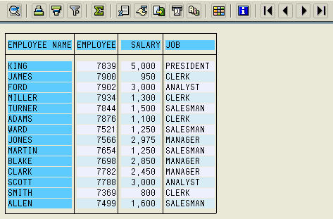
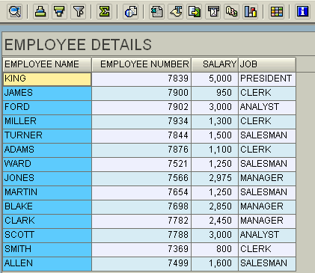
Display Output Internal Table
RESUSE_ALV_LIST_DISPLAY
REUSE_ALV_GRID_DISPLAY

Slide 12
Demo
ALV List Display and ALV Grid Display

Slide 13
Field Catalog
A field catalog is prepared using the internal table (I_FIELDCAT) of type SLIS_T_FIELDCAT_ALV
Field catalog containing descriptions of the list output fields (usually a subset of the internal output table fields)
A field catalog is required for every ALV list output to add desired functionality (i.e. Key, Hotspot, Specific headings, Justify, Col. position etc) to certain fields of the output.
If not mentioned specifically, then the defaults are taken

Slide 14
No of ways to build Field Catalog
Preparing the data dictionary structure
Build field catalog using function module
Reuse_alv_fieldcatlog_merge
Prepare the field Catalog manually

Slide 15
Demo
Create a Field Catalog Manually and use it in list display

Slide 16
OO ALV
The Control Framework is required for OO ALV as it provides global classes for various functionalities.
CL_GUI_ALV_GRID
The wrapper class implemented to encapsulate ALV Grid functionality for list display.

Slide 17
Basic Components
While preparing a list to be displayed via an ALV grid control, we have some basic components to prepare. These are:
List data :
Data in an internal table to be listed
Field Catalog :
Define specifications on how the fields of our list will be displayed
Has technical and additional information about display options for each column to be displayed.
The internal table for the field catalog must be referenced to the dictionary type LVC_T_FCAT.
Container
Storage area where the list will be displayed.
It should be of type CL_GUI_CUSTOM_CONTAINER

Slide 18
Basic Components
Layout Structure :
Fill a structure to specify general layout options for the grid
To set
general display options
grid customizing
totals options
color adjustments etc...
The layout structure must be of type LVC_S_LAYO.

Slide 19
Basic Components
Event Handler
To handle events triggered by the ALV Grid instance.
Upon creating ALV Grid instance, register an instance of this event handler class to handle ALV Grid events
Various Events are as follows
Print_Top_Of_Page:
Used for Headers. Handler is ‘SET HANDLER’.
Print_End_Of_Page
Used for Footers. Handler is ‘SET HANDLER’.
OnDropComplete
Event to change the state after a successful drag and drop operation.
OnDrag
To ‘fetch’ information from the drag source.
OnDrop
Used to use the dragged information in combination with drop source. Here, it should be checked whether the operation is successful

Slide 20
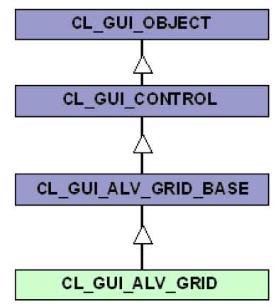
Grid Control – Inheritance Hierarchy
CL_GUI_ALV_GRID’ class encapsulates communication with the instance on the presentation server, along with many other functions. For this reason, you should instantiate this class, not its super class.

Slide 21
Steps to work with OO ALV
Create an object of class CL_GUI_CUSTOM_CONTAINER.
Create an object of class CL_GUI_ALV_GRID.
Populate the internal table to display on the GRID.
Call the screen that contains the CUSTOM CONTAINER, in which the list has to be displayed.
Call the screen.
Call the method SET_TABLE_FOR_FIRST_DISPLAY of class CL_GUI_ALV_GRID and pass the required parameters

Slide 22
CL_GUI_ALV_GRID
‘CL_GUI_ALV_GRID’ class provides various methods and Events

Slide 23
Building Field Catalog
There are 3 methods for doing this:
Automatic generation
Semi-automatic generation
Manual generation

Slide 24
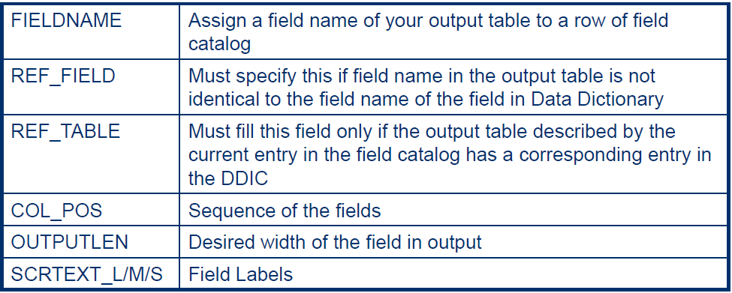
Structure of Field Catalog (LVC_T_FCAT)

Slide 25
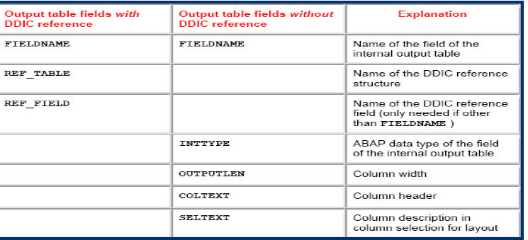
Building Field Catalog (Manually)
The work in this procedure is just filling the internal table for the field catalog. We have already seen the structure of a field catalog. To achieve filling the field catalog correctly, one must at least fill the above fields of the field catalog structure for each column of the list.

Slide 26
Building Field Catalog (Manually)
DATA LS_FCAT TYPE LVC_S_FCAT .
LS_FCAT-FIELDNAME = 'CARRID‘.
LS_FCAT-INTTYPE = 'C'.
LS_FCAT-OUTPUTLEN = '3'.
LS_FCAT-COLTEXT = 'CARRIER ID'.
LS_FCAT-SELTEXT = 'CARRIER ID'.
APPEND LS_FCAT TO PT_FIELDCAT.
CLEAR LS_FCAT.
LS_FCAT-FIELDNAME = 'CONNID'.
LS_FCAT-REF_TABLE = 'SFLIGHT'.
LS_FCAT-REF_TABLE = 'CONNID'.
LS_FCAT-OUTPUTLEN = '3'.
LS_FCAT-COLTEXT = 'CONNECTION ID'.
LS_FCAT-SELTEXT = 'CONNECTION ID'.
APPEND LS_FCAT TO PT_FIELDCAT .
…. AND SO ON FOR ALL THE FIELDS TO BE DISPLAYED IN THE List

Slide 27
Demo
Create a Field Catalog Manually and use it in list display

Slide 28
Building Field Catalog (Semi-automatically)

Slide 29
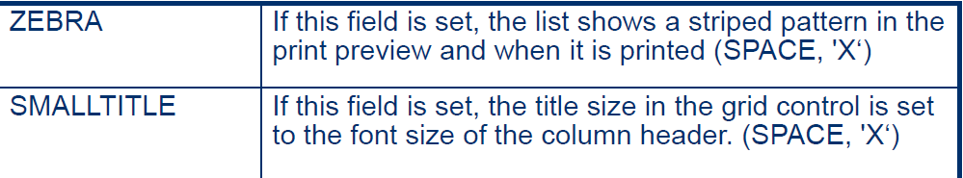
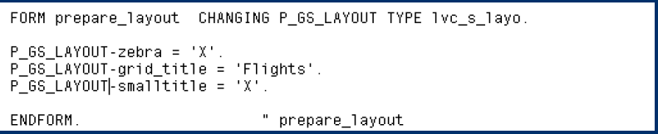
Layout Adjustment
It comes now painting our ALV Grid in a general aspect. To define general appearance of our ALV Grid we fill a structure of type “LVC_S_LAYO”. This table contains fields and functionalities serviced by this adjustment. Some of the generally used options are as below:

Slide 30
ALV Display
Data transfer to the ALV control takes place during the call of method “SET_TABLE_FOR_FIRST_DISPLAY” of class “CL_GUI_ALV_GRID”. The method call must be programmed at the PBO event of the screen with the SAP Grid Control container.
Remember to use Pattern > ABAP Objects > Method of a Class

Slide 31
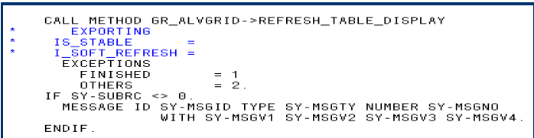
ALV Display
If the ALV_GRID is initial (First Call) the method “SET_TABLE_FOR_FIRST_DISPLAY” is called as described in the previous slide. Else on subsequent calls; “REFRESH_TABLE_DISPLAY” is called. Reason being; there is no need to instantiate the Custom Container, Grid every time in the PBO of the Screen.
The parameters of this method:
IS_STABLE: If the row or column field of this structure is set, the position of the scroll bar for the rows or columns remains stable.
I_SOFT_REFRESH: If set, any totals created, any sort order defined and any filters set for the data displayed remain unchanged when the grid control is refreshed.

Slide 32
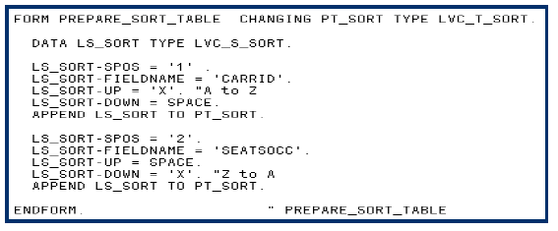
Setting Sort Condition
It is possible to set sort conditions for the table data. This is achieved by filling an internal table of structure “LVC_T_SORT” which consists of the sort criteria. To have an initial sorting, pass it to the parameter “IT_SORT” of the method “SET_TABLE_FOR_FIRST_DISPLAY”.

Slide 33
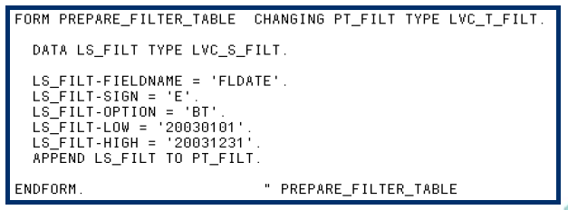
Setting Filter Condition
The procedure is like the one in sorting. Here, the type of the table you must fill is “LVC_T_FILT”.
Filling this table is similar to filling a RANGES variable.

Slide 34
Event Based Functionality
Additional Event based Functionalities that the ALV Grid can handle:-
GENERAL SCHEME FOR THE EVENT HANDLER CLASS
HOTSPOT CLICKING
DOUBLE CLICKING
PUSHBUTTONS ON THE LIST
ADDING YOUR OWN FUNCTIONS
OVERRIDING STANDARD FUNCTIONS
MAKING ALV GRID EDITABLE
CONTROLLING DATA CHANGES
LINKING F1 HELP TO FIELDS
LINKING F4 HELP TO FIELDS

Slide 35
Summary
In this lesson, you have learnt:
Control Framework
ALV Grid
Non Event Based Functionality
Event Based Functionality

Slide 36
Review Question
Question 1: _______ is used to find the length of the string.
Question 2: Condense and Concatenate command perform the same function.
True/False

